Slide 1
CIS108-6 Data Modelling, Management and Governance
Week 1
Introduction
Gangmin Li
(Office hours: 13:00-17:00 every Friday)

Slide 2
Today’s schedule
Unit Overview
Data, Information, Knowledge
Knowledge, information and data Systems
Data, Database Management Systems (DBMS)
Relational DBMS (RDBMS)
IS Development Methods

Slide 3
Unit overview

Slide 4
Relevance
BIG data Age. Data is everywhere, and generated with an unprecedent speed. Data is the most valuable assets for every organisations
Make use of it becomes difficult due its BIG properties
Managing data is crucially important in any field AI, ML, IS and KS
Its application facilitates the rational decision making process that is the basis for successful operations within any business and in any environment
Manage data is foundation for any business activities

Slide 5
The purpose of the unit
To discuss how data should be modelled and managed during its lifecycle through a mixture of relevant topics includes data modelling, system development tools
Basic techniques for data capture, modelling, storing, retrieval and services as the mechanisms for making effective and efficient use of available data.
To enable students to develop an application system that rely on data as a solution to a problem for a particular field of application.
To enable students possess the knowledge related with a data system running issues in an organisation.

Slide 6
Aim and Objectives
Advance knowledge by exploring and applying theoretical and practical techniques for data modelling and management
To develop appropriate relational database systems for managing data within a chosen field of interest
Review database and data modelling theory & techniques
Appreciate and exploit available methods & techniques
Develop awareness & ability to select & apply appropriate tools & techniques to build database systems
Demonstrate good practice
Apply data modelling & management tools in field of interest
Notes:
Aims and objectives of DMM unit

Slide 7
Syllabus
Introduction to Data and Data Management Systems
Data Modelling and Dynamic Modelling Techniques (e.g. UML, Semantic modelling)
Data system design:
Conceptual Database Design (Entity-Relationship models)
Logical Database Design (Normalisation)
Data querying (e.g. SQL)
Maintenance of a data system (Integrity, Security, Recovery and Concurrency)
Trends and Future Developments (e.g. Data Warehousing)
Role of XML schemas and ontology harmonization is fulfilling eGovernance needs. Introduction to XML/XSL, schemas, DTD’s. Application to eGovernance

Slide 8
Learning Outcomes
Demonstrate the following knowledge and understanding. Exhibit a balanced and systematic understanding and knowledge of data modelling and management theory and data governance practice (including querying languages).
Demonstrate the following skills and abilities. Apply knowledge of data modelling and management concepts to design, develop and critically evaluate an information system within a chosen field of interest.

Slide 9

Summary Learning Hours
20% lectures
16% guided self study
Independent study 39% (118 hours)
Autonomous 25% (74 hours)
192 Extra hours from you!!!!

Slide 10
Guided Study
The study is part of planed contents dissemination.
It could be review the lecture contents, key points and nontrivial (sticky) points
It can also be extended study of key knowledge points
Instruction will be provided (including check points)
They are mandated learning
Identified by “Guided study” on BREO

Slide 11
Independent Study
A vast amount of your time will be self-directed studies (192 hrs) to broad and supplement lectures
Besides lecture notes, you should also consider external sources
YouTube videos
Google Scholar (http://scholar.google.com/)
Search engines (Google, Bing, …)
Research Management Tools (e.g., Mendeley http://www.mendeley.com/)
https://stackoverflow.com/

Slide 12
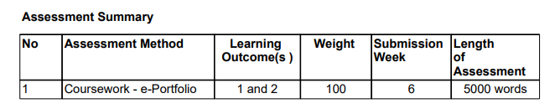
Assessments
Words are simple guided indicators.
NOT literally counting of the word.
Idea and deliberation are MORE important!

Slide 13
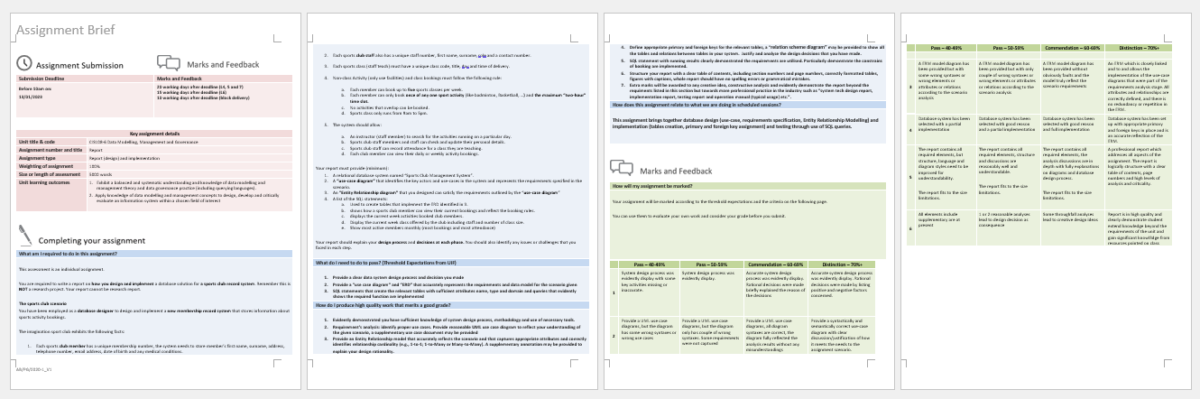
Assignment briefing
https://breo.beds.ac.uk/ultra/courses/_61983015_1/outline/edit/document/_7673030_1?courseId=_61983015_1

Slide 14
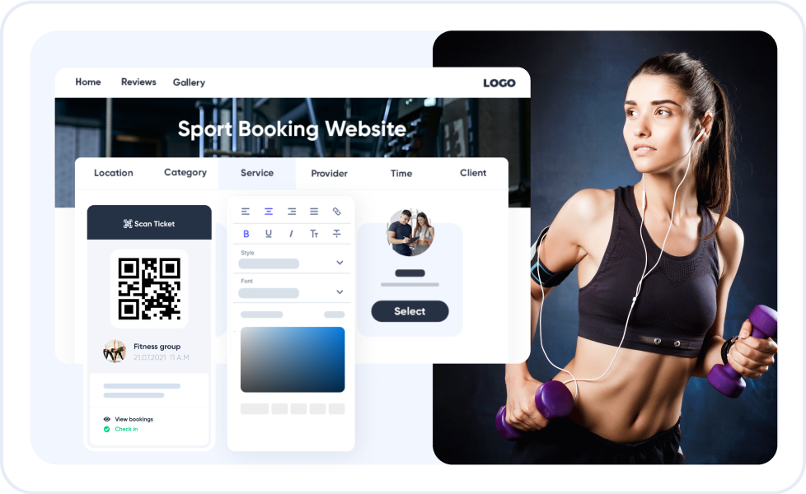
Problem Scenario

Slide 15
Sport Club
Design and implement a Sportclub record system
that stores information about sports activity and taught class bookings.
The operational rules:
Each member can book up to five sports classes per week.
Each member can only book once of any one sport activity (like badminton, Basketball, …) and the maximum “two-hour” time slot.
No activities that overlap can be booked.
Sports class only runs from 9am to 5pm but activity can run from 6am to 10pm.
The system should allow:
An instructor (staff member) to search for the activities running on a particular day.
Sports club staff members and staff can check and update their personal details.
Sports club staff can record attendance for a class they are teaching.
Each club member can view their daily or weekly activity bookings.

Slide 16
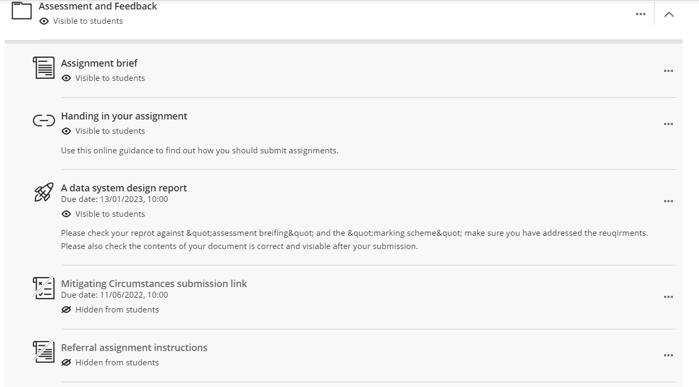
Assignment submission

Slide 17
Basic assumption of you
To be a “Master in ….”
A Matual person
Knowing what you want
Knowing that I am here to help but if you don’t learn, there is nothing I can do!
Six weeks is short. If you did not spend enough time you are wasting money and life
University have RULES everyone should follow

Slide 18
How to write academic report for computing
Introduction to report writing: https://beds.hosted.panopto.com/Panopto/Pages/Viewer.aspx?id=c202e4d1-ecb8-44f0-83b2-ac4500db82eb
Structuring an academic paragraph: https://beds.hosted.panopto.com/Panopto/Pages/Viewer.aspx?id=e6f9c866-f004-40e0-82e5-ac4500db84a0
Academic Writing – FOCSI: https://beds.hosted.panopto.com/Panopto/Pages/Viewer.aspx?id=1f47b416-6da8-4486-8791-ac4500db8251
Linking words: https://beds.hosted.panopto.com/Panopto/Pages/Viewer.aspx?id=1f7ce0ea-b0d6-4868-8592-ac4500db83f6
Referencing for computing: https://beds.hosted.panopto.com/Panopto/Pages/Viewer.aspx?id=b7d25d6f-c533-49ca-8c57-ac32011da616

